Slide 1




INTERNSHIP
PRESENTATION
Internship Tutor in ISEP:
Xun ZHANG
Saad EL JAOUHARI
Presented by:
Fahadh Mohamed JAHEER HUSSAN - 62720
Date: 03/09/2024
Internship Tutor in Abeeway:
Stéphane BOUDAUD
1

Slide 2


TABLE OF CONTENT
Introduction
Presentation of Abeeway
Objective of Internship
Project Description
Project Planning
Achievements
Future Enhancement and scalability
Professional growth
Managerial analysis
Conclusion
2

Slide 3
INTRODUCTION
Company: Abeeway
Location: Biot, France
Role: Junior Software Engineer
Tasks:
Developed an automated testing tool for the new firmware, Asset Tracker 3 (AT3).
Developed an user interface to display and analyze test results.
Validated firmware functionality.
Internship Duration: 11/03/2024 - 10/09/2024 (6 Months)
Internship Tutor: Stéphane BOUDAUD, R&D Senior Director of Engineering
3

Slide 4


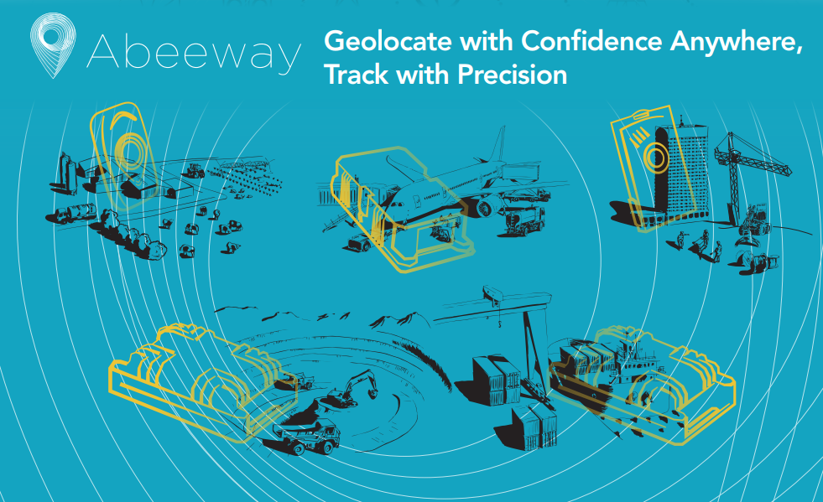
PRESENTATION OF ABEEWAY
Founded: In 2014
Specializes: Low-power, cutting-edge geolocation and real-time tracking IOT solutions for businesses and individuals. Specialists in LoRa technology.
Serving industries: Agriculture, logistics, security, and telecommunications.
Global presence: Through partners and distributors in over 60 countries, employing around 20 people.
4

Slide 5

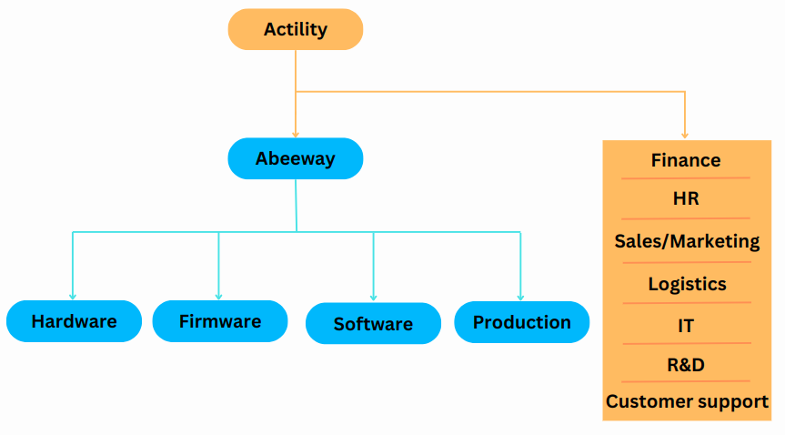

ORGANIZATION
Actility is a leading provider of Low Power Wide Area Network (LPWAN) solutions for the Internet of Things (IoT). Their core product, ThingPark, is a network management platform that supports technologies like LoRaWAN, LTE-M, and NB-IoT.
In 2017: Abeeway became a part of the Actility group.
Impact of integration: Enabled Abeeway to expand its global footprint and continue its growth as a key player in the geolocation and IoT sectors.
5

Slide 6
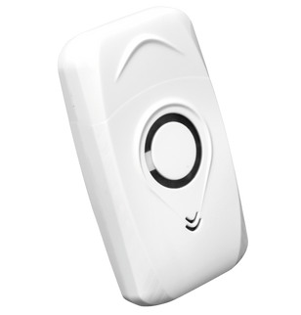
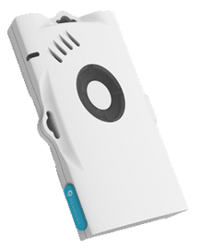
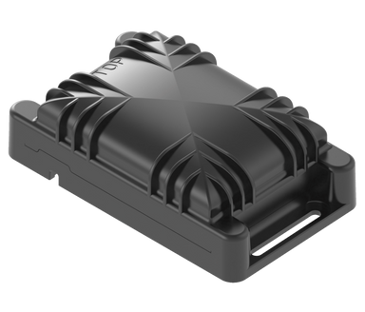

PRODUCTS
All trackers perform both indoor and outdoor geolocation using low-power GPS, WiFi-sniffer, and BLE, and they operate on AT2 firmware.
Fused Geolocation: Needed to accurately track locations both indoors (using BLE/Wi-Fi) and outdoors (using Wi-Fi/GNSS).
Micro Tracker:
Compact, durable device for tracking valuables, people, or pets.
Small size and rechargeable battery.
Smart Badge:
ID card-format tracker with accurate indoor/outdoor geolocation, SOS button, and buzzer.
Ideal for workforce safety, zone notifications and rechargeable battery.
Compact Tracker:
Suited for harsh environments.
Provides seamless tracking for heavy-duty and primary battery with long battery life.
6

Slide 7
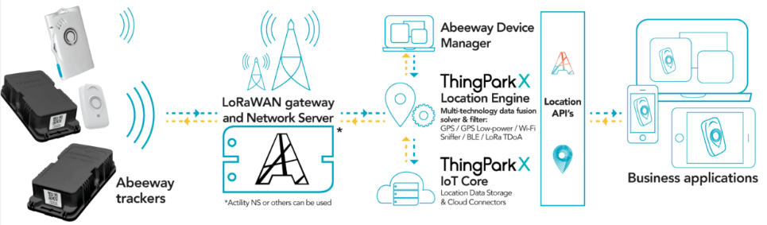
THINGPARK ARCHITECTURE
Common hardware and share a unified backend for data collection and analysis.
ThingParkX Location Engine: Enhances accuracy by integrating LP-GPS, Wi-Fi, and BLE. Uses advanced post-processing algorithms for precise location data.
Management Tools: Abeeway Device Manager and mobile app allow configuration and behavior management, facilitating the encoding and decoding of tracker payloads.
7

Slide 8
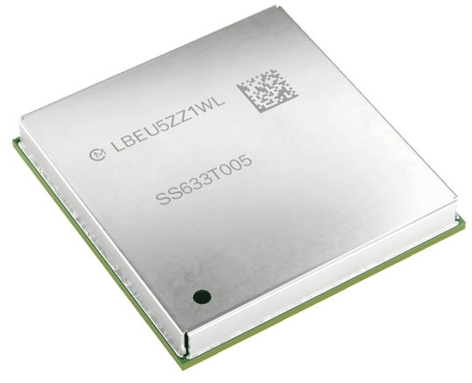
OBJECTIVE OF INTERNSHIP
Previous Tracker Models:
LoRa transceiver, Application MCU, GNSS receiver, Wi-Fi transceiver, BLE transceiver were individually mounted on the PCB.
New Geolocation Module:
Co-developed by Abeeway and Murata.
It integrates the LR1110 transceiver (Lora/WIFI sniffer), STM32WB chipset (BLE and MCU), and GNSS receiver into one compact unit, requiring the new AT3 firmware.
The transition to the AT3 firmware requires thorough testing to ensure that the complex integrated module performs efficiently and reliably.
Automated testing tool
User interface
Validate AT3 firmware
8

Slide 9
PROJECT DESCRIPTION
Understanding the geoloc module plateform and AT3 Firmware.
Developed a generic QA core algorithm for automated testing.
Developed a user interface to facilitate access to the generic QA core algorithm.
Validated firmware functionalities with the generic QA core algorithm:
Validated payload data.
Validated geolocation acquisitions.
Validated uplink functionality using MQTT.
Validated downlink functionality using MQTT.
Documented and released the QA automation tool.
9

Slide 10
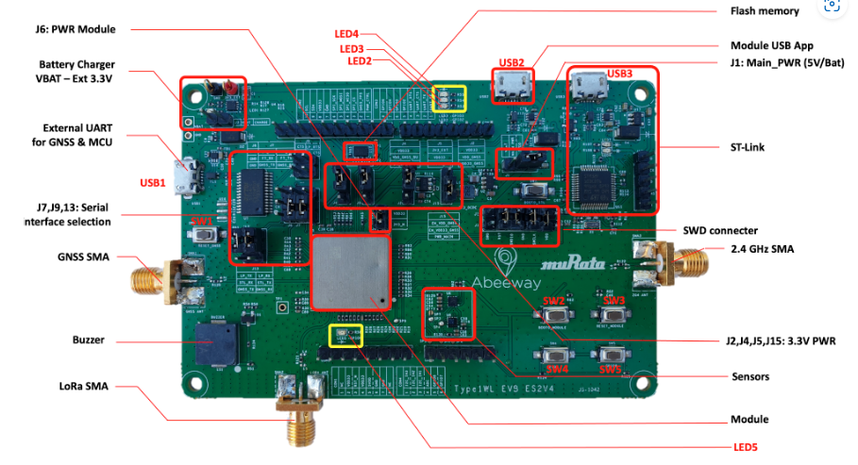
UNDERSTANDING THE GEOLOC MODULE PLATEFORM AND AT3 FIRMWARE
GEOLOCATION MODULE EVALUATION KIT (EVK)
Firmware Testing: Utilized the Geolocation Module Evaluation Kit (EVK) designed for application development with geolocation modules.
Radio Systems: Accessible via SMA connectors for LoRaWAN, WiFi sniffing, BLE sniffing, and GNSS.
10

Slide 11
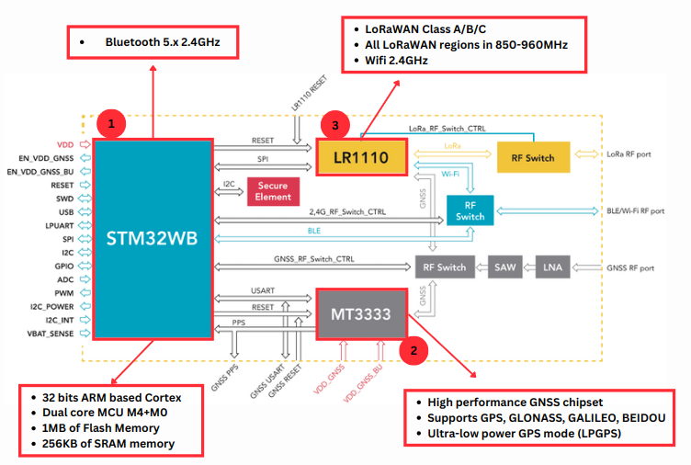
GEOLOC MODULE
11

Slide 12
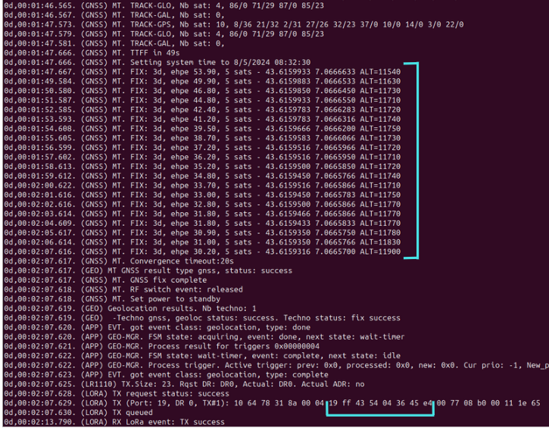
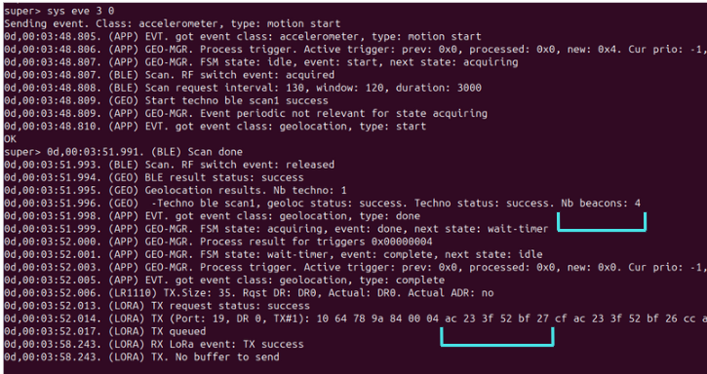
AT3 FIRMWARE
AT3 Firmware: Provides comprehensive tracking capabilities with advanced geolocation technologies such as GNSS, BLE, and Wi-Fi. It also supports Low Power Wide Area Network (LPWAN) technology, enabling long-range communication with low power consumption, making it ideal for IoT applications.
High Configurability: Supports various use cases in geolocation applications.
GNSS FIX
LATITUDE/LONGITUDE
MAC ADDRESS OF BLE BEACON
GNSS Acquisition
Ble Acquisition
12

Slide 13
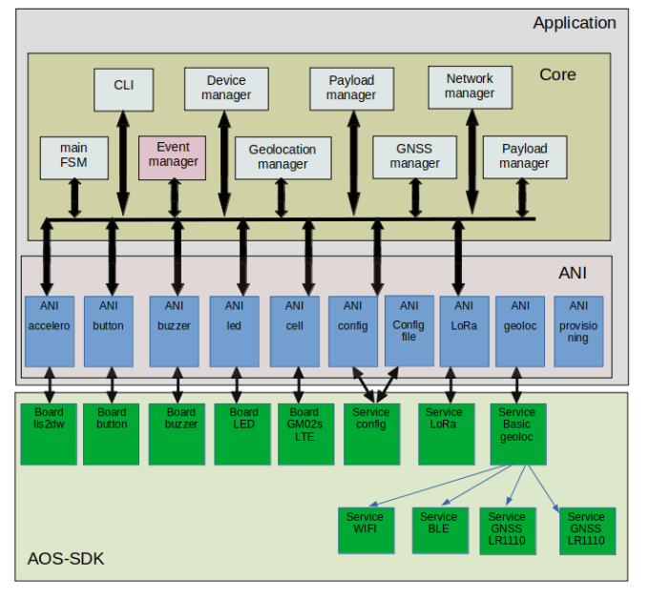
ARCHITECTURE OF AT3 FIRMWARE
AOS-SDK (Abeeway Operating system - Software development kit)
The AOS-SDK has specific drivers for each services.
The application architecture consists of two main layers: the Application Node Interface (ANI) and the Core.
The ANI connects the application with underlying services, managing specific functions like sensors and communication.
The Core layer oversees system management, including state control, event handling, geolocation, networking, device monitoring etc..
13

Slide 14

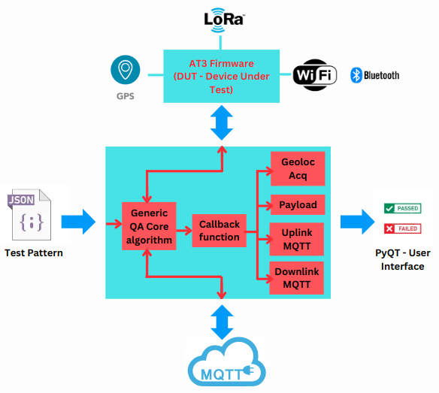

DEVELOPED A GENERIC QA CORE ALGORITHM FOR AUTOMATED TESTING
The generic QA core algorithm was designed to efficiently execute a wide range of test cases,
generate result and debug files, and be scalable for future test additions.
14

Slide 15
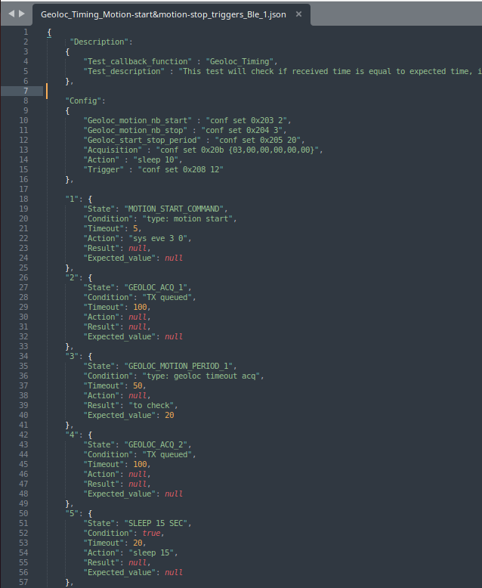
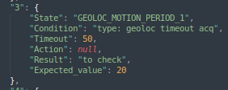
Test Pattern entry in JSON format
State Management
State - Name of the test state
Condition - The expected response from the AT3 firmware
Timeout - The time limit for this state
Action - The command to be sent to the firmware
Result - Whether the result should be checked (e.g., "to check")
Expected Value - The value that should be verified against the response
Three types of fail: Result Fail, Timeout Fail, Loop Fail
15

Slide 16
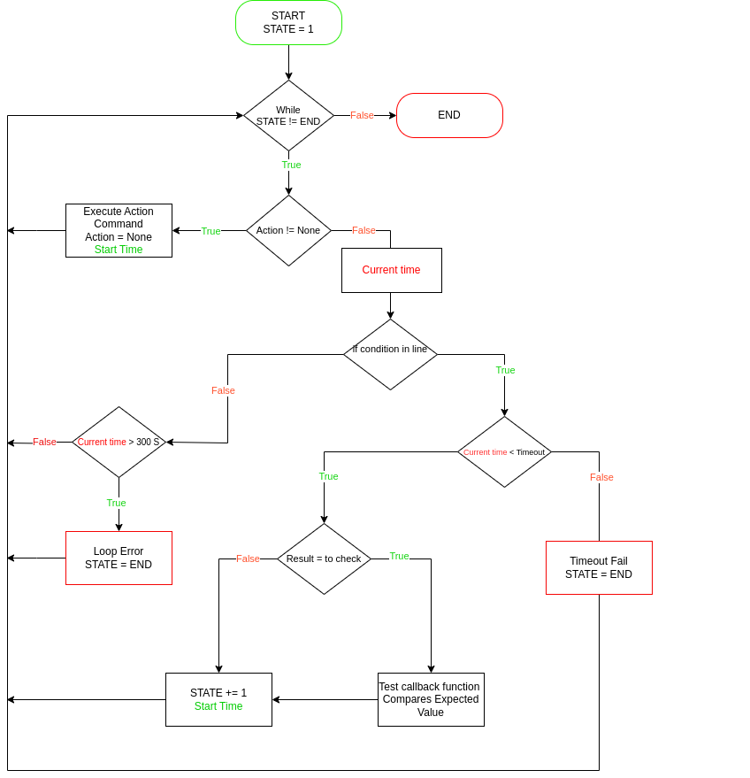
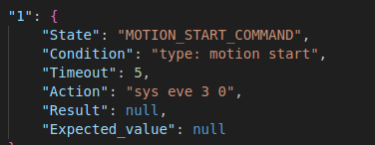
BLOCK DIAGRAM OF THE GENERIC QA CORE ALGORITHM
16

Slide 17
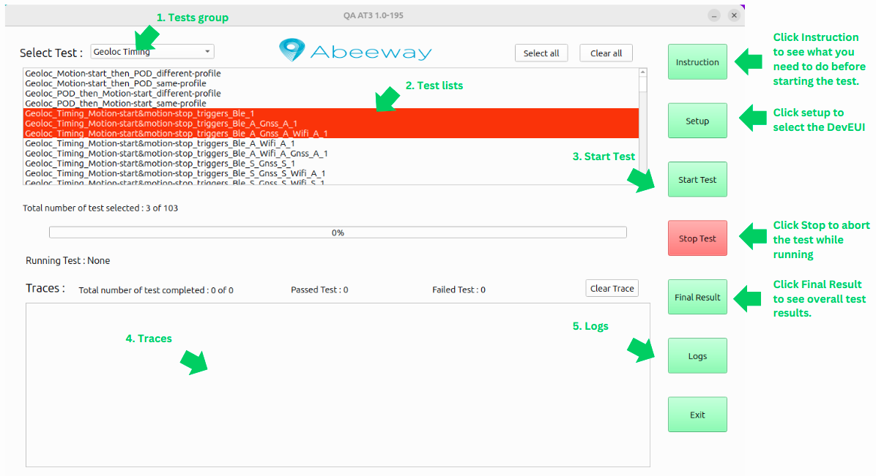
DEVELOPED A USER INTERFACE TO FACILITATE ACCESS TO THE GENERIC QA CORE ALGORITHM.
Main Window:
Qt: A powerful framework used to create applications with graphical interfaces, like buttons, windows, and menus.
17

Slide 18
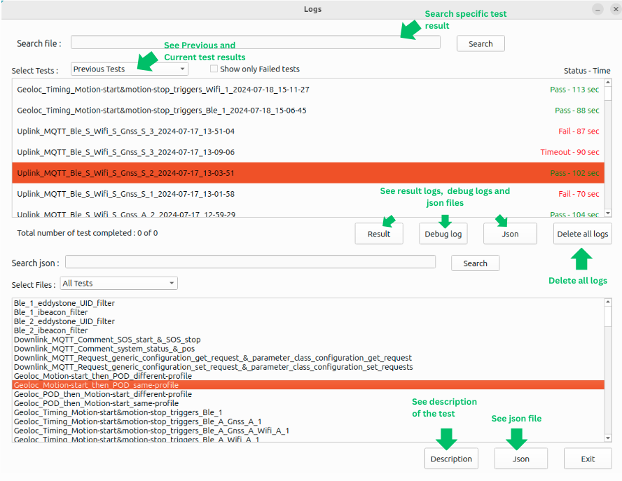
Log Window:
18

Slide 19
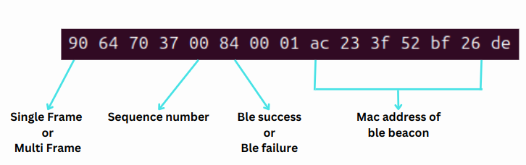
VALIDATED FIRMWARE FUNCTIONALITIES WITH THE GENERIC QA CORE ALGORITHM
VALIDATED PAYLOAD DATA
Payload Type: Determining whether the payload is a single frame or multi-frame.
Sequence Number: Verifying the sequence number of each payload to ensure proper order and uniqueness.
Acquisition Result: Determining whether the acquisition is success or failure.
Data Accuracy: Comparing the received payload data with the expected values, such as MAC addresses for BLE, Wi-Fi, and latitude/longitude for GNSS.
19

Slide 20
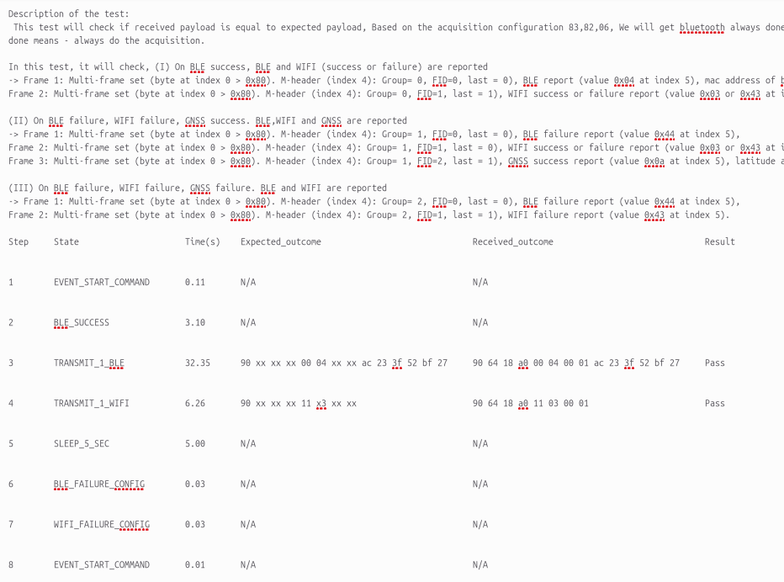
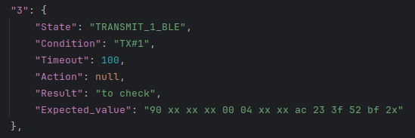
GENERATED PAYLOAD RESULT FILE
Test Pattern
Log file
20

Slide 21
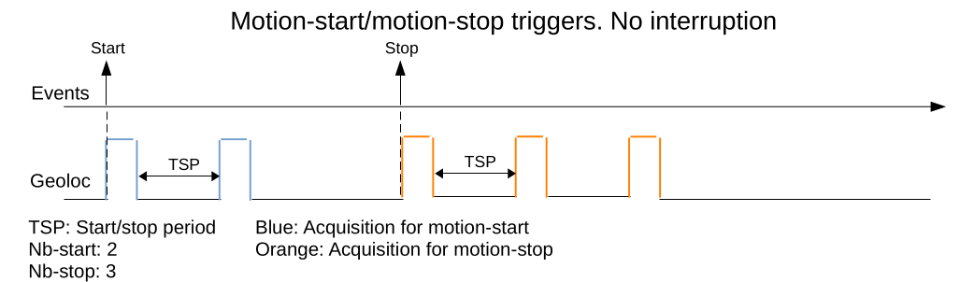
VALIDATED GEOLOCATION ACQUISITIONS
When motion starts, there should be a 2-acquisition TSP (Time Slot Period) interval, and when motion ends, there should be a 3-acquisition TSP interval.
Firmware Configuration: Accurately measuring the timing between acquisition events required a deep understanding of the firmware’s scheduling and configuration.
Bug Identification: A timing discrepancy was found and reported to the development team for further investigation.
21

Slide 22
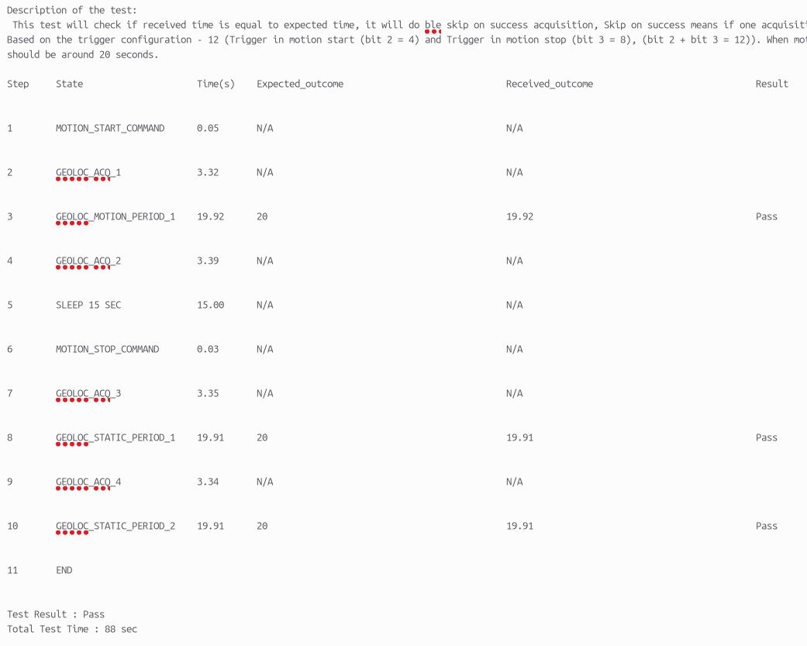
GENERATED GEOLOCATION ACQUISITION RESULT FILE
Test Pattern
Log file
22

Slide 23
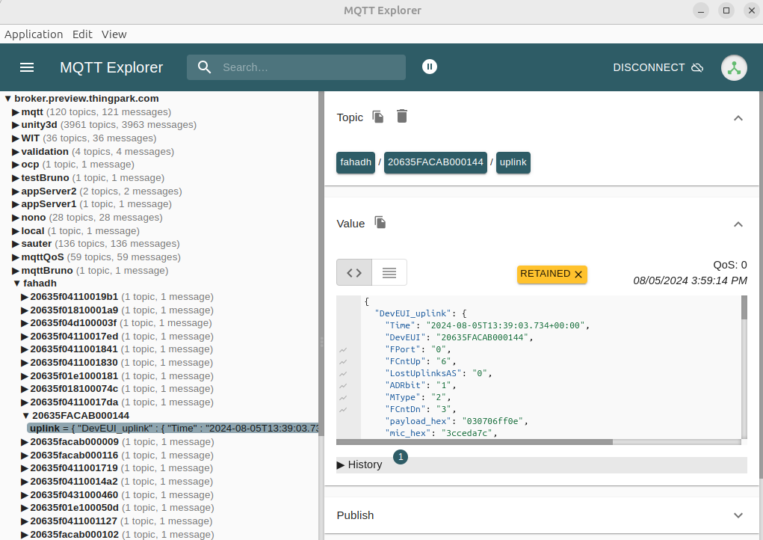
VALIDATED UPLINK FUNCTIONALITY USING MQTT
Challenge: A synchronization issue arose between uplink payloads from MQTT and those generated by the firmware.
Solution: Implemented a LIFO queue mechanism to compare the most recent payloads, resolving timing discrepancies.
Bug Identification: A mismatch between the firmware's reported spreading factor and MQTT data was discovered and reported to the development team for further investigation.
23

Slide 24
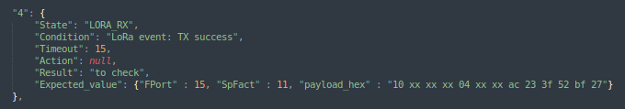
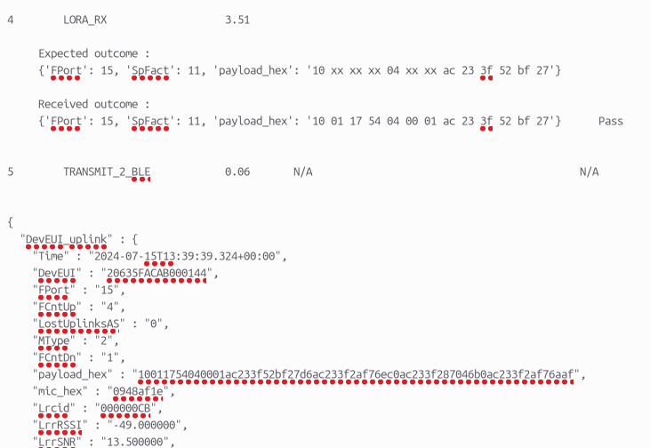
GENERATED UPLINK MQTT RESULT FILE
Test Pattern
Log file
24

Slide 25
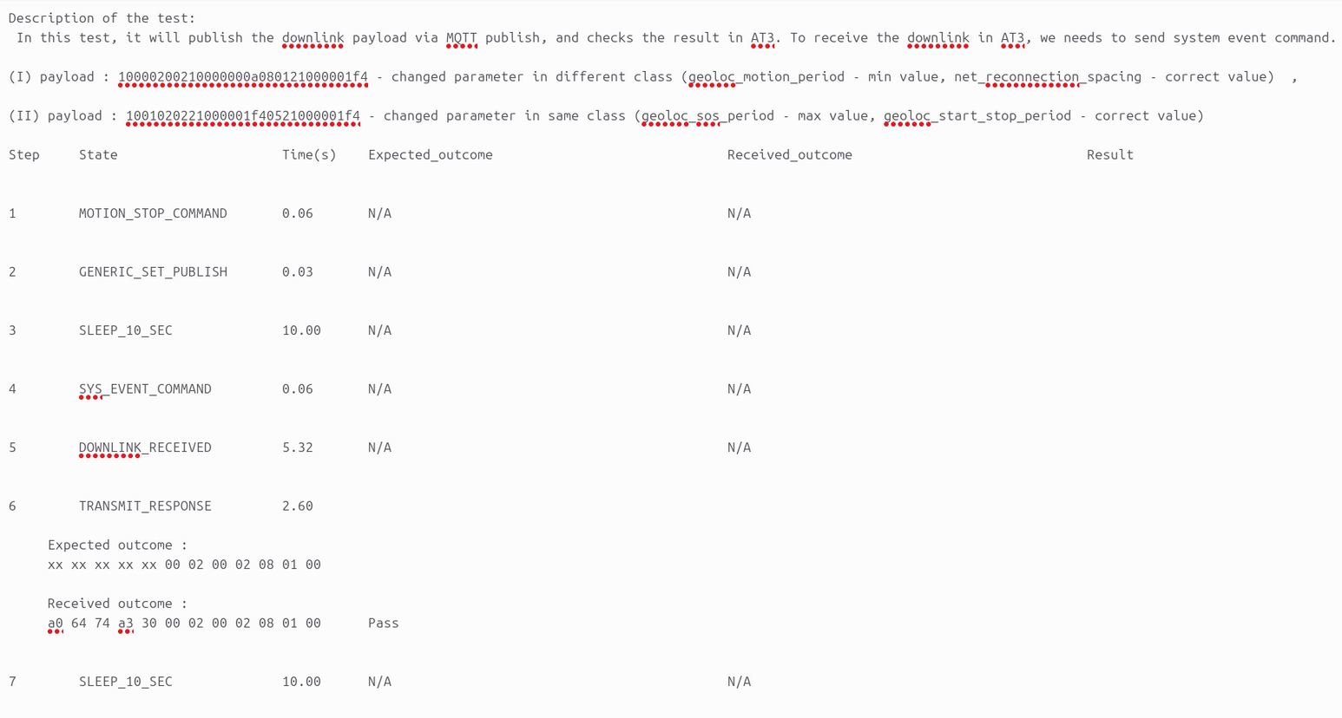
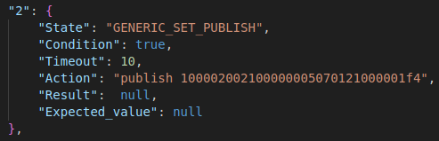
VALIDATED DOWNLINK FUNCTIONALITY USING MQTT
Test Pattern
Log file
Challenge: Understanding how to correctly change parameters and activate SOS features using downlink payloads.
Required a detailed understanding of payload formatting and sending to make desired changes in the firmware.
25

Slide 26
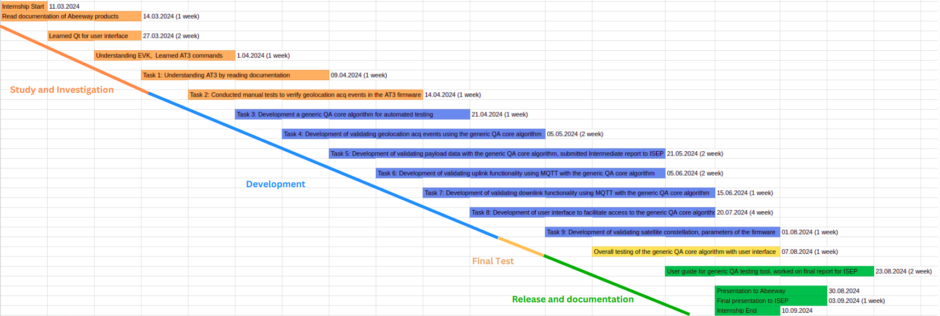
PROJECT PLANNING
26

Slide 27
ACHIEVEMENTS
Developed an Automated Testing Tool: Created an automated tool to test the new Asset Tracker 3 (AT3) firmware, significantly reducing manual testing efforts and to ensure a high quality product.
Designed a User Interface: Developed a user-friendly interface to display and analyze test results, improving the efficiency of the testing process.
Validated Firmware Functionality: Created over 100 test cases and thoroughly tested the AT3 firmware to ensure reliable geolocation and tracking performance.
Enhanced Firmware Debugging: Identified and reported over 20 critical bugs, including timing issues, incorrect spreading factors, and automatic resets, improving the firmware overall.
Collaborated Effectively with Teams: Worked closely with the firmware development team, contributing to troubleshooting and enhancing product performance.
27

Slide 28
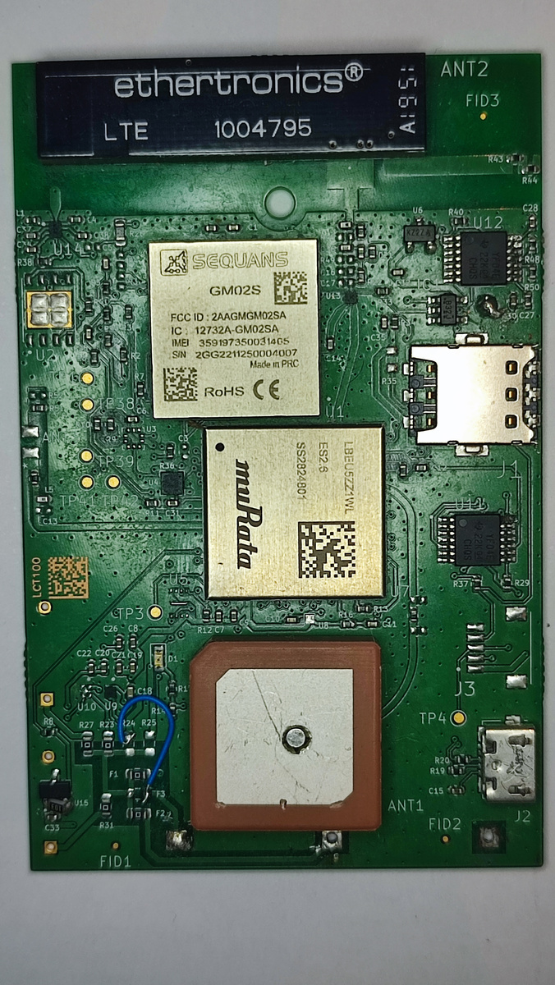
FUTURE ENHANCEMENT AND SCALABILITY
Abeeway's AT3 firmware is being upgraded to support LTE-M and NB-IoT technologies with Sequans Communications modules.
This update improves location data transmission via LoRaWAN or LTE based on network availability.
The QA core algorithm from the internship can be adapted to test these new cellular features, ensuring ongoing firmware optimization.
Beyond this project, the tool is versatile enough to validate other projects by adapting to different technologies and applications, ensuring broad testing and reliability.
28

Slide 29
PROFESSIONAL GROWTH
Technical Skills: Improved Python, Linux, MQTT, Gitlab and PyQt skills while developing an automated testing tool for the AT3 firmware.
Collaboration and Communication: Enhanced communication and collaboration through regular meetings with the Abeeway team. French proficiency improved.
Project Management: Developed strong time management and prioritization skills using tools like Gantt charts.
Adaptability and Problem-Solving: Learned to quickly adapt and troubleshoot in a dynamic environment.
Innovation and Continuous Improvement: Focused on automating processes and identifying solutions to improve efficiency.
29

Slide 30
MANAGERIAL ANALYSIS
Carbon Footprint Overview
Research: In 2021, Abeeway and Actility's combined carbon footprint was 608 tCO2e. The two main contributors were material purchases by Abeeway - 255.1 tCO2e, and cloud service - 118.3 tCO2e.
Other sources included commuting (37.2 tCO2e) and air travel (15.4 tCO2e).
Interview Insights: Patrick Beatini, Firmware Manager, acknowledged that reducing emissions from materials is challenging due to strict quality requirements, but more sustainable sourcing is needed.
Actions Already Taken:
Developed optimized firmware for low power consumption, extending battery life.
Replacing plastic packaging with eco-friendly cardboard alternatives.
Using recycled plastics in the manufacturing of tracker enclosure.
Shipping by boat rather than by air to reduce carbon emissions.
Recommendations:
Add solar panels to trackers to extend battery life.
Use bio batteries that are biodegradable and recyclable.
Use data centers powered by renewable energy.
30

Slide 31
CONCLUSION
My internship at Abeeway was an invaluable experience where I worked with advanced geolocation technologies and complex firmware in a dynamic, startup-like environment that fostered autonomy and proactive problem-solving.
I developed a QA core algorithm for the AT3 firmware, created a testing interface, and validated key functionalities using MQTT. With over 100 test cases, I identified more than 20 critical bugs, significantly enhancing the firmware and product quality.
This experience sharpened my technical skills, deepened my understanding of advanced technologies, and prepared me for future roles in technology and engineering. I am grateful for my time at Abeeway and ready for new challenges.
31

Slide 32
THANK YOU
QUESTIONS ?

